Slide 1
Node JS - http
S.Karthiga

Slide 2
Session Outcomes
At the end of this session, students will be able to,
Apply http module for the given problem

Slide 3
HTTP Module
Node.js has a built-in module called HTTP, which allows Node.js to transfer data over the Hyper Text Transfer Protocol (HTTP).
To include the HTTP module, use the require() method:
var http = require('http');

Slide 4
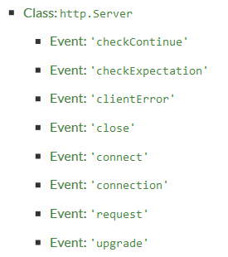
http Module
The HTTP module creates an HTTP server that listens to server ports and gives a response back to the client.
createServer( ) – create a web-server
Server instance
http.Server -> extended from net.Server
listen() function is for listening connections
close() – stops the server from accepting connections

Slide 5
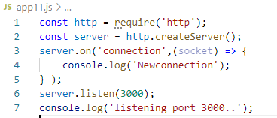


http – code & output

Slide 6
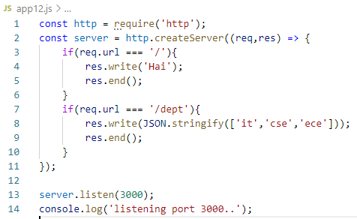



http

Slide 7
Demo

